Slide 1

Fibonacci Extension

Slide 2
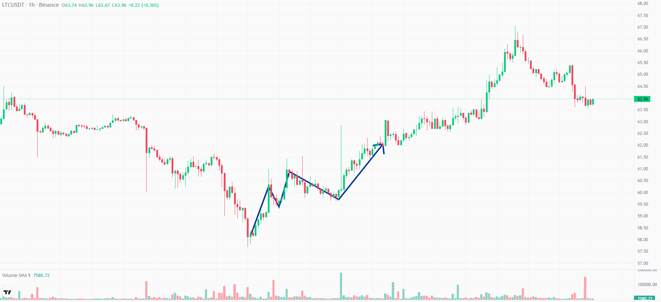
Determining Exit
Notes:
After taking an entry, the second thing that comes to mind is an exit position
Draw a path determining your first high low.

Slide 3
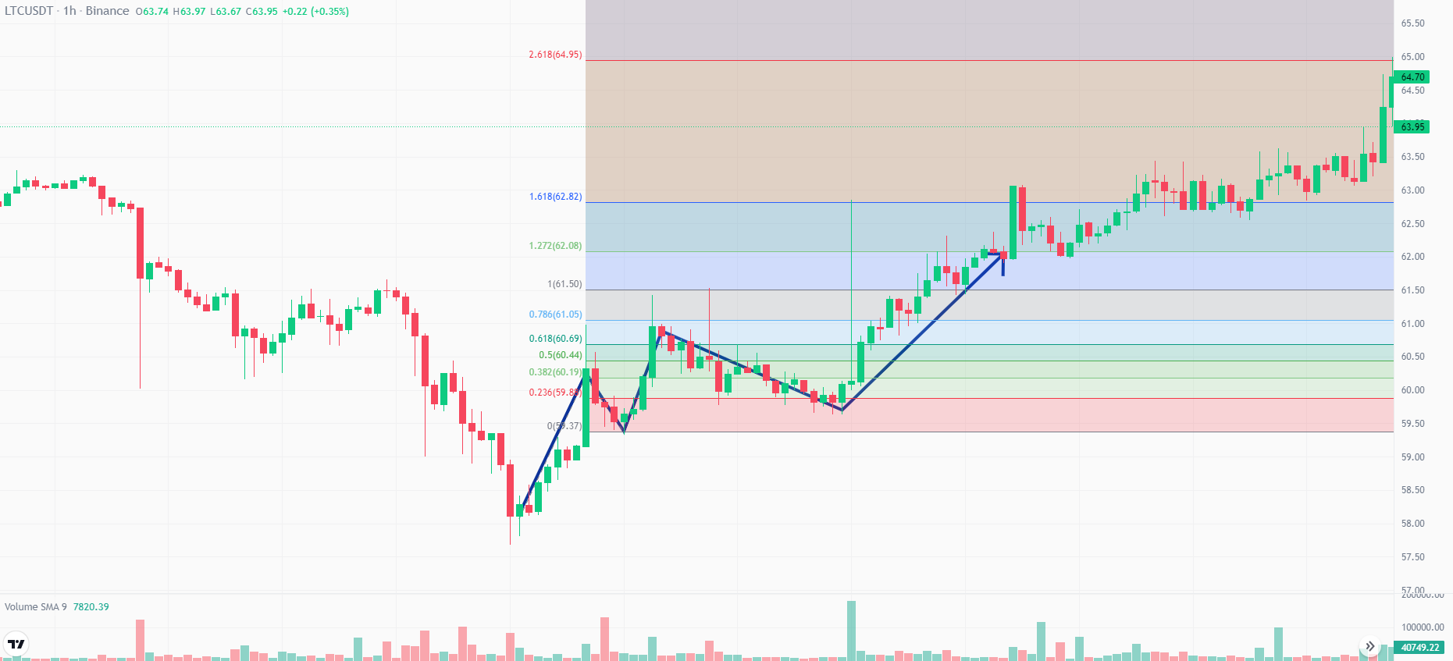
Fibonacci Extension
Notes:
The three points of fibonacci extension would be the LL, HH, HL. Turn on 1.2 fibonacci, stoploss at first HL.

Slide 4
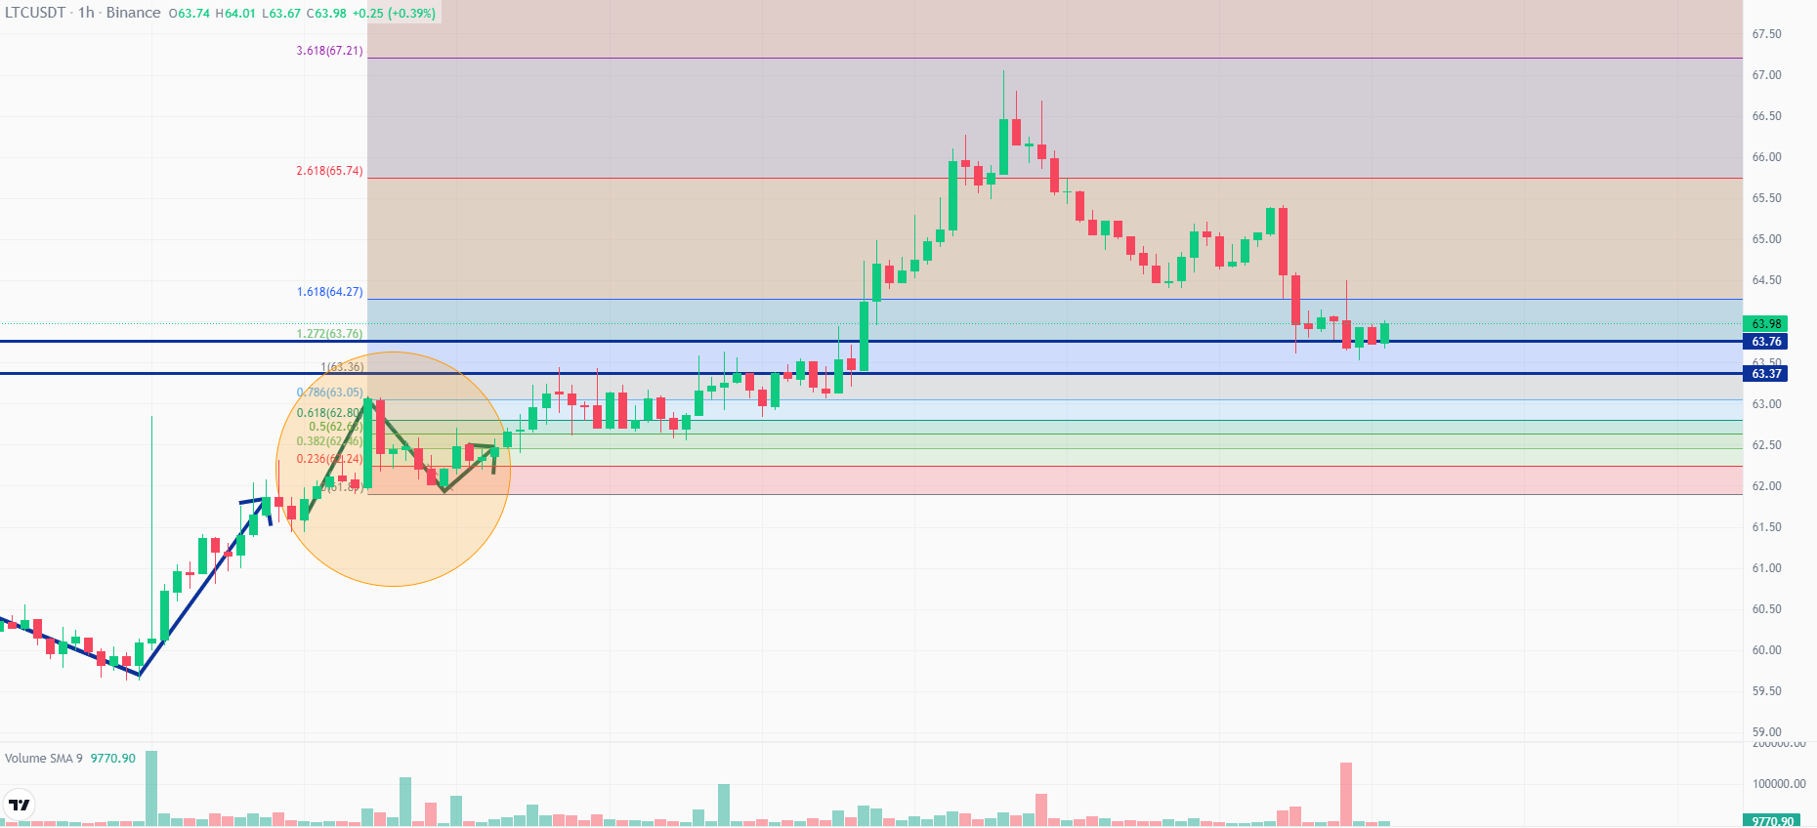
Target at 1 and 1.2
Notes:
The first minimum viable target would be 1. Then the next target would be 1.2.

Slide 5
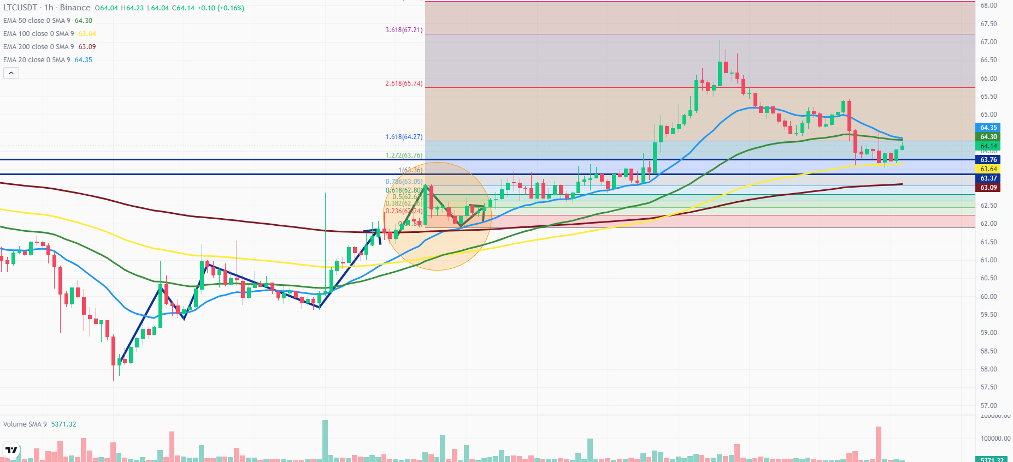
Riding EMAs
Notes:
Riding EMA 20,50,100,200

Slide 6
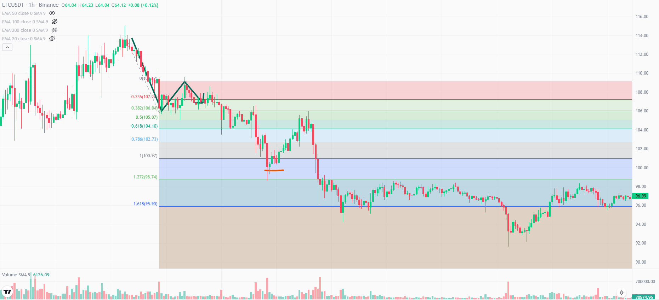
Determining Support in Downtrend
Notes:
Riding EMA 20,50,100,200

Slide 7
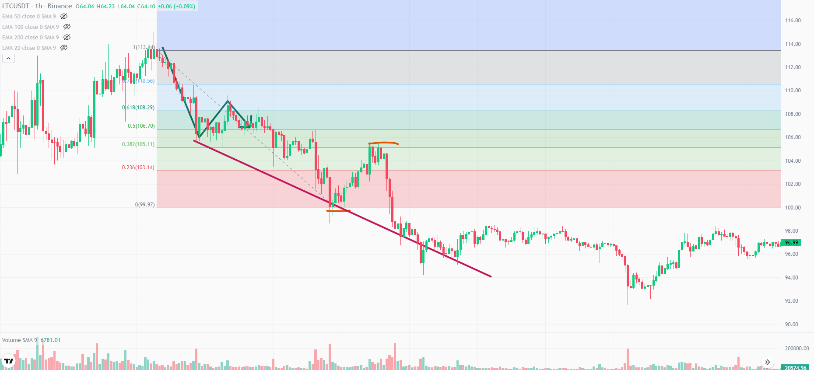
Entry in a Downtrend
Notes:
Riding EMA 20,50,100,200

Slide 8
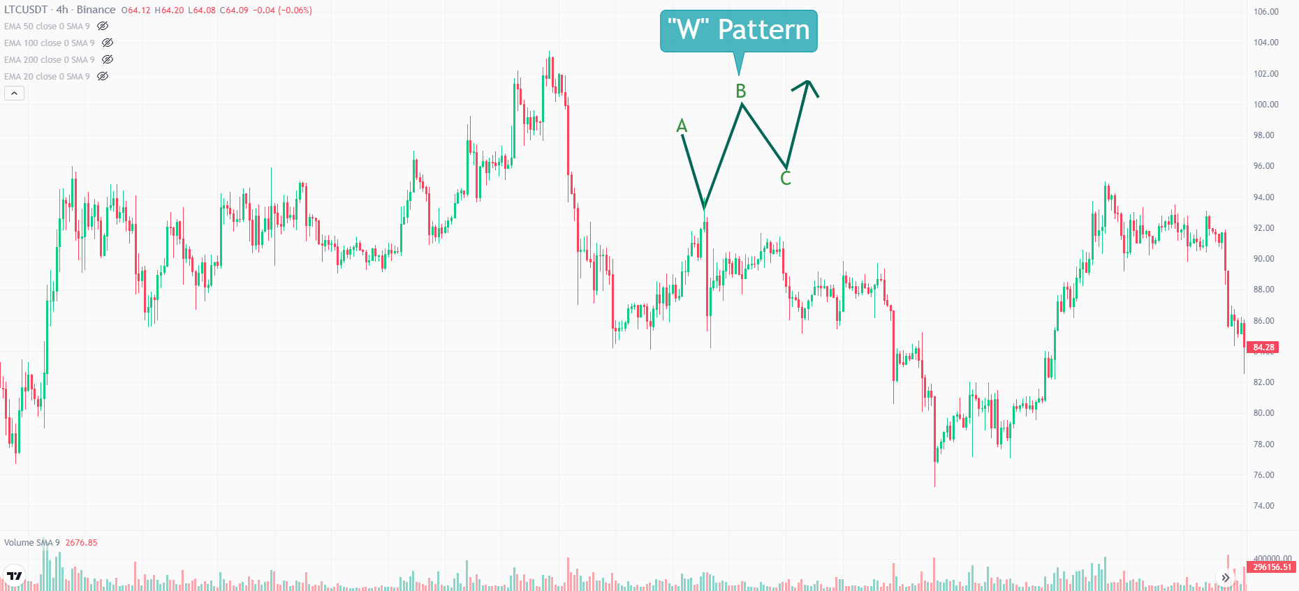
Advanced Value Action
Remember HH, HL, LL, LH ?
Swing HL, LH
Notes:
Explain W pattern – After Downtrend

Slide 9
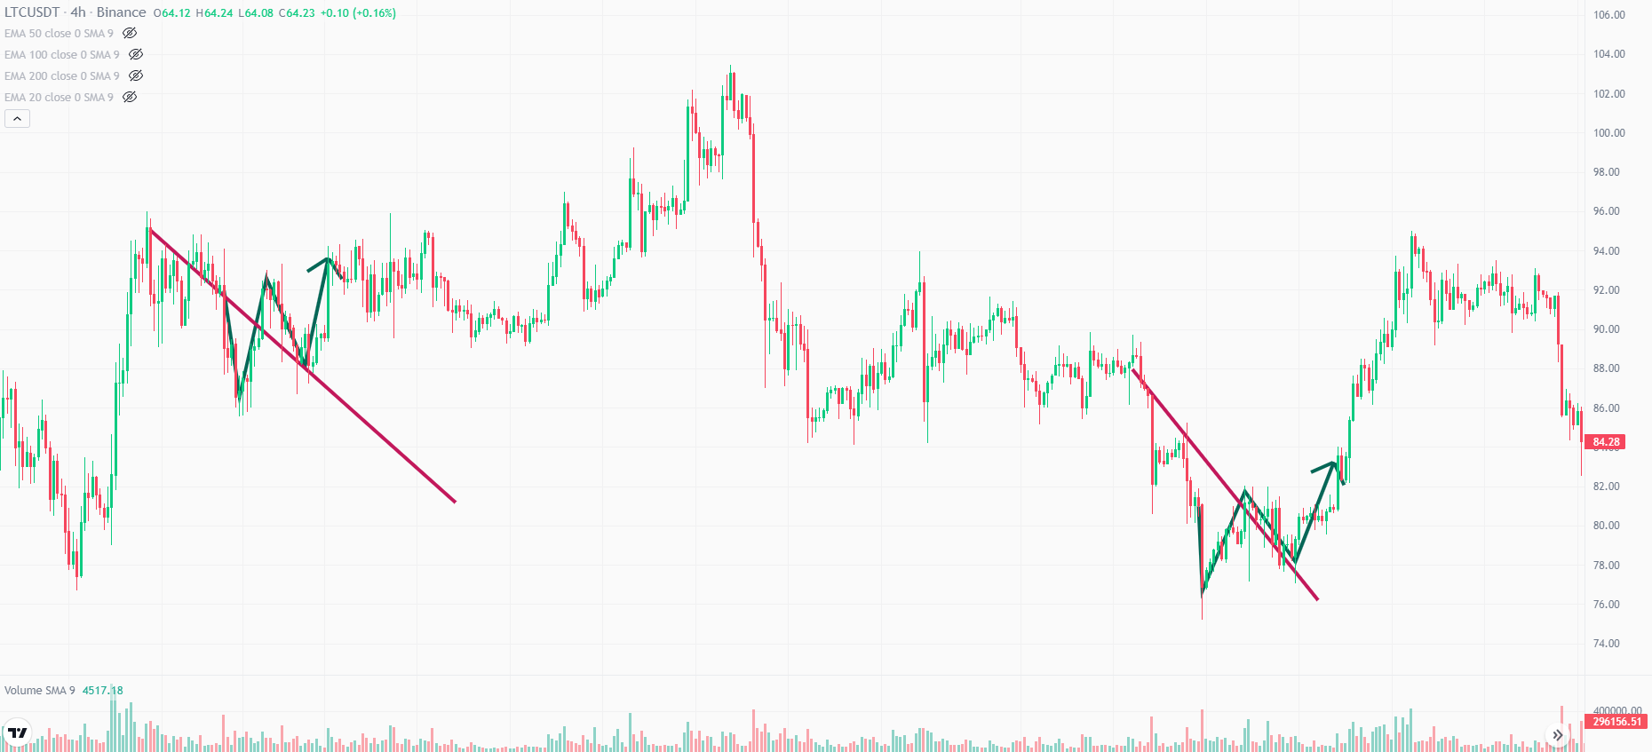
Advanced Value Action

Slide 10
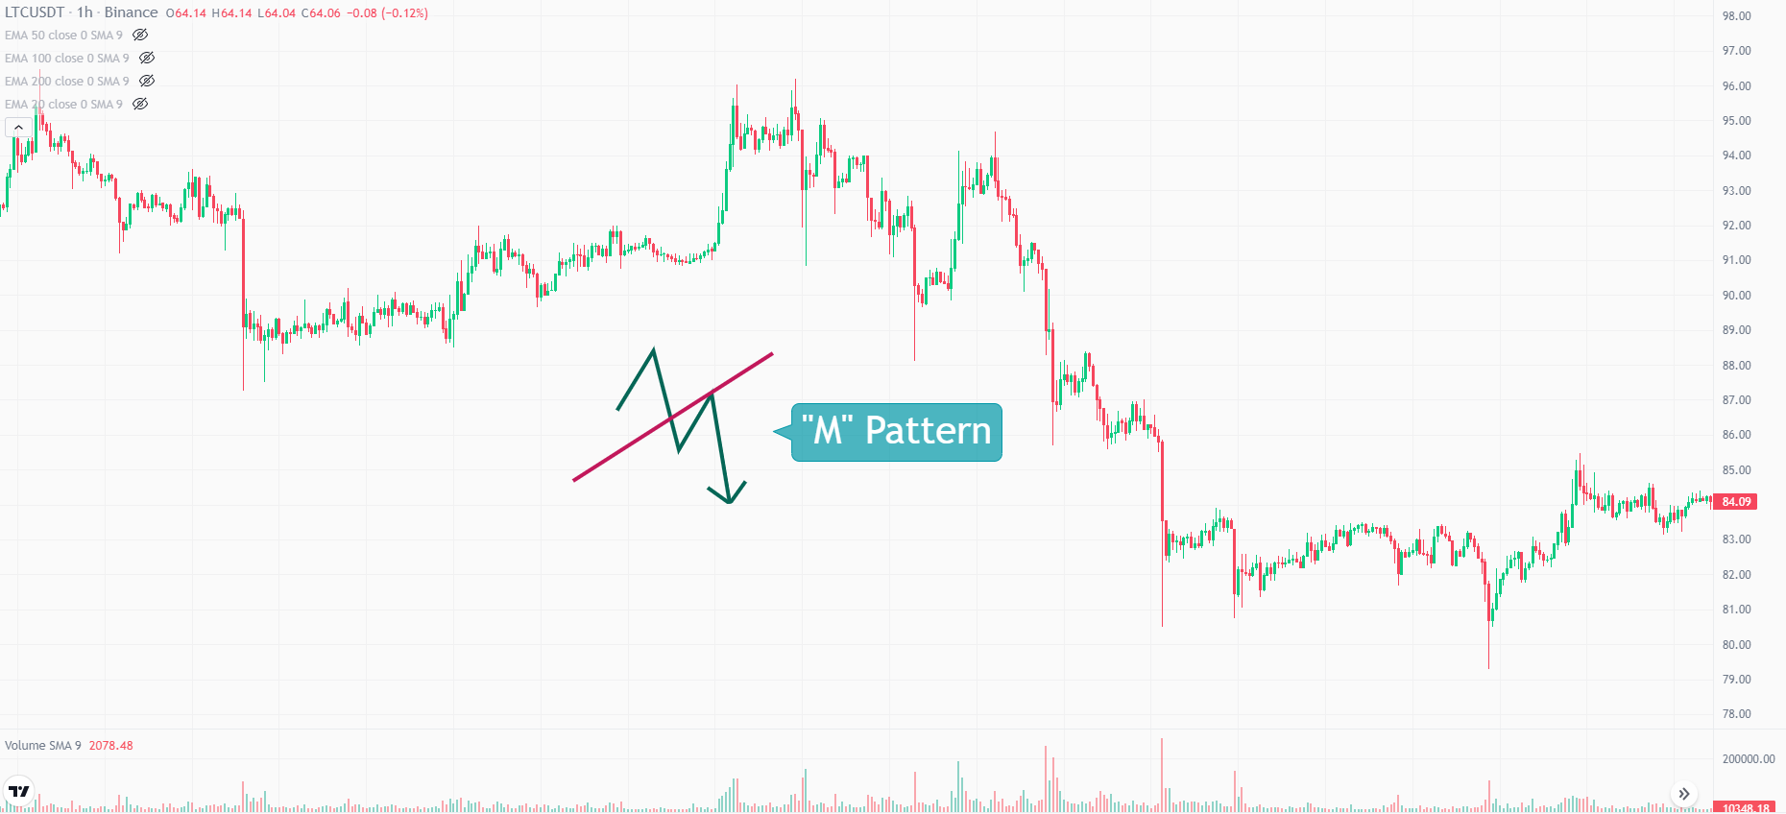
Advanced Value Action
Notes:
Explain “M” Pattern – After Uptrend

Slide 11
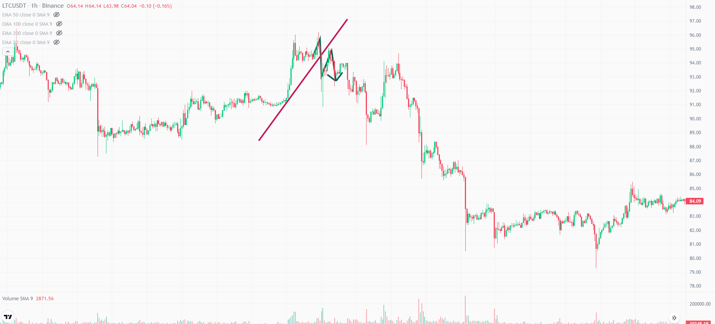
Advanced Value Action
Notes:
Explain “M” Pattern – After Uptrend

